Slide 1
Module 3: Data Science Methodology
Analytics for Data Science, Examples of Data Analytics, Data Analytics Lifecycle: Data Discovery, Data Preparation, Model Planning, Model Building, Communicate Results.

Slide 2
What is Data?
Data is everything that surrounds us.
It can be seen in the form of images, texts, audios, videos, signals, etc.
The quantities, characters, or symbols on which operations are performed by a computer, which may be stored and transmitted in the form of electrical signals and recorded on magnetic, optical, or mechanical recording media.
Digital transformation from the last few decades is the reason why enormous data is getting generated every moment.

Slide 3
What is Big Data?
Big Data is a collection of data that is huge in volume, yet growing exponentially with time.
It is a data with so large size and complexity that none of traditional data management tools can store it or process it efficiently.
Big data is also a data but with huge size.

Slide 4
What is an Example of Big Data?
The New York Stock Exchange is an example of Big Data that generates about one terabyte of new trade data per day.
The statistic shows that 500+terabytes of new data get ingested into the databases of social media site Facebook, every day. This data is mainly generated in terms of photo and video uploads, message exchanges, putting comments etc.
A single Jet engine can generate 10+terabytes of data in 30 minutes of flight time. With many thousand flights per day, generation of data reaches up to many Petabytes.

Slide 5
Types of Big Data?
Following are the types of Big Data:
Structured
Unstructured
Semi-structured
Structured
Any data that can be stored, accessed and processed in the form of fixed format is termed as a ‘structured’ data.
Structured data has a well-defined structure, i.e., in columns and rows, So that it can be easily managed, accessible, and used by humans or computers.
However, nowadays, we are foreseeing issues when a size of such data grows to a huge extent, typical sizes are being in the rage of multiple zettabytes.
10²¹ bytes equal to 1 zettabyte or one billion terabytes forms a zettabyte.

Slide 6
Examples of Structured Data
An ‘Employee’ table in a database is an example of Structured Data.
Employee_ID | Employee_Name | Gender | Department | Salary_In_lacs
2365 | Rajesh Kulkarni | Male | Finance | 650000
3398 | Pratibha Joshi | Female | Admin | 650000
7465 | Shushil Roy | Male | Admin | 500000
7500 | Shubhojit Das | Male | Finance | 500000
7699 | Priya Sane | Female | Finance | 550000

Slide 7
Unstructured Data
Any data with unknown form or the structure is classified as unstructured data. In addition to the size being huge, un-structured data poses multiple challenges in terms of its processing for deriving value out of it.
A typical example of unstructured data is a heterogeneous data source containing a combination of simple text files, images, videos etc.
Now a days, organizations have wealth of data available with them but unfortunately, they don’t know how to derive value out of it since this data is in its raw form or unstructured format.

Slide 8
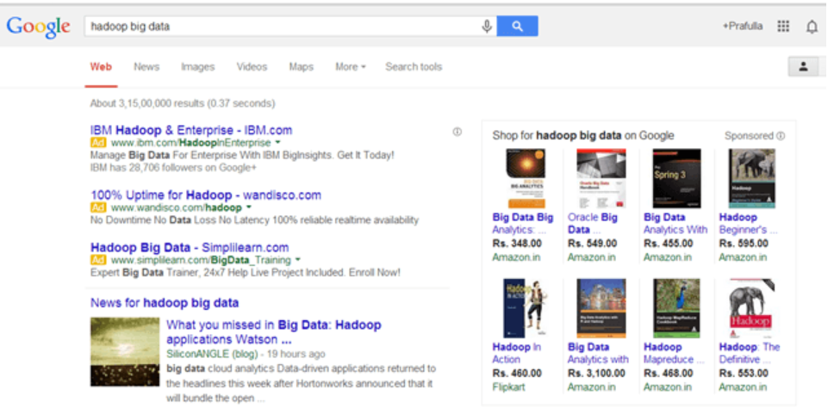
Examples of Unstructured Data
The output returned by ‘Google Search’

Slide 9
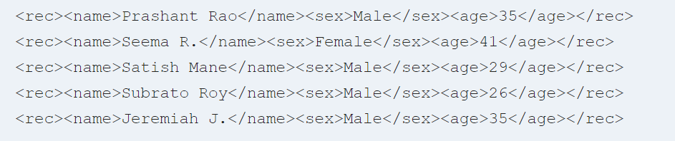
Semi-structured
Semi-structured data is a type of structured data that does not adhere to the formal structure in relational databases or other types of data tables, but instead includes tags or other markers to distinguish semantic elements and maintain hierarchies of record within the data.
Semi-structured data can contain both the forms of data. We can see semi-structured data as a structured in form but it is actually not defined with e.g. a table definition in relational DBMS.
Example of semi-structured data is a data represented in an XML file.
Examples Of Semi-structured Data
Personal data stored in an XML file.

Slide 10
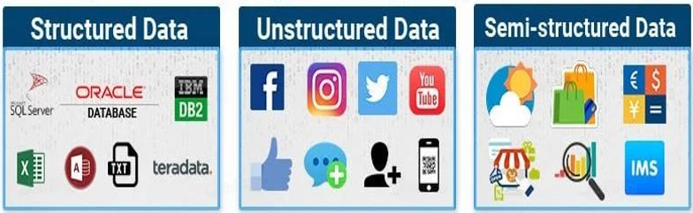
Big Data Types
Relational databases are examples of structured data.
Examples of unstructured data include audio, video.
Semi-structured data includes the XML data, JSON files, and others.

Slide 11
Sources of Big Data
Social networking sites: Facebook, Google, LinkedIn all these sites generates huge amount of data on a day to day basis as they have billions of users worldwide.
E-commerce site: Sites like Amazon, Flipkart, Alibaba generates huge amount of logs from which users buying trends can be traced.
Weather Station: All the weather station and satellite gives very huge data which are stored and manipulated to forecast weather.
Telecom company: Telecom giants like Airtel, Vodafone study the user trends and accordingly publish their plans and for this they store the data of its million users.
Share Market: Stock exchange across the world generates huge amount of data through its daily transaction.

Slide 12
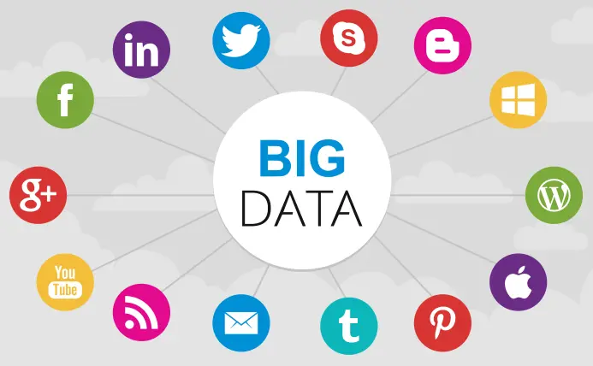
Sources of Big Data

Slide 13
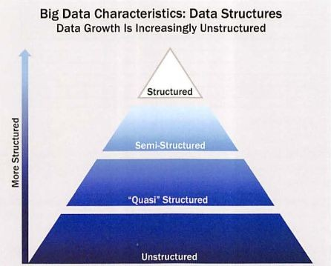
Quasi-structured data is more of a textual data with erratic data formats. It can be formatted. with effort, tools, and time. An example of quasi-structured data is the data about webpages a user visited and in what order.

Slide 14
Data Structures: Characteristics of Big Data
Structured
Transactional data, OLAP cubes, RDBMS, CSV files, spreadsheets
Semi-structured
Text data with discernable patterns – e.g., XML data
Quasi-structured
Text data with erratic data formats – e.g., clickstream data
Unstructured
Data with no inherent structure – text docs, PDF’s, images, video

Slide 15
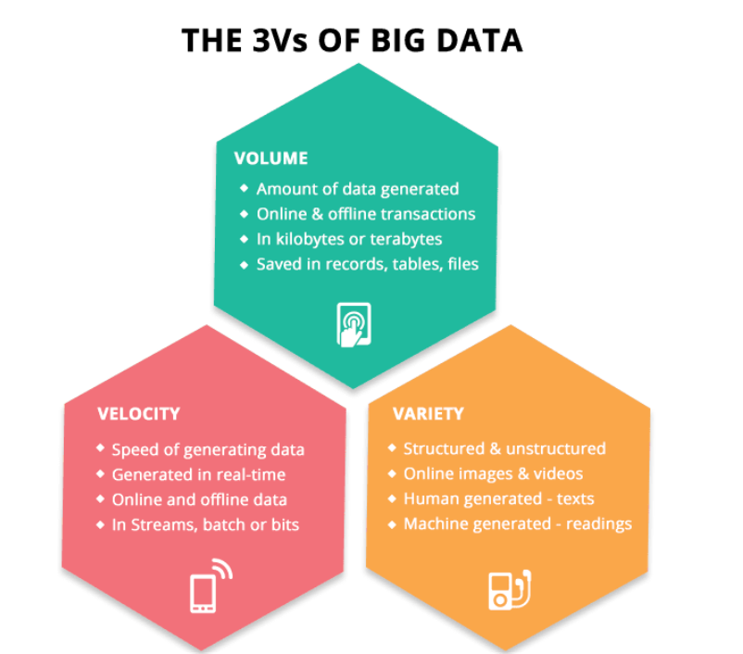

Slide 16
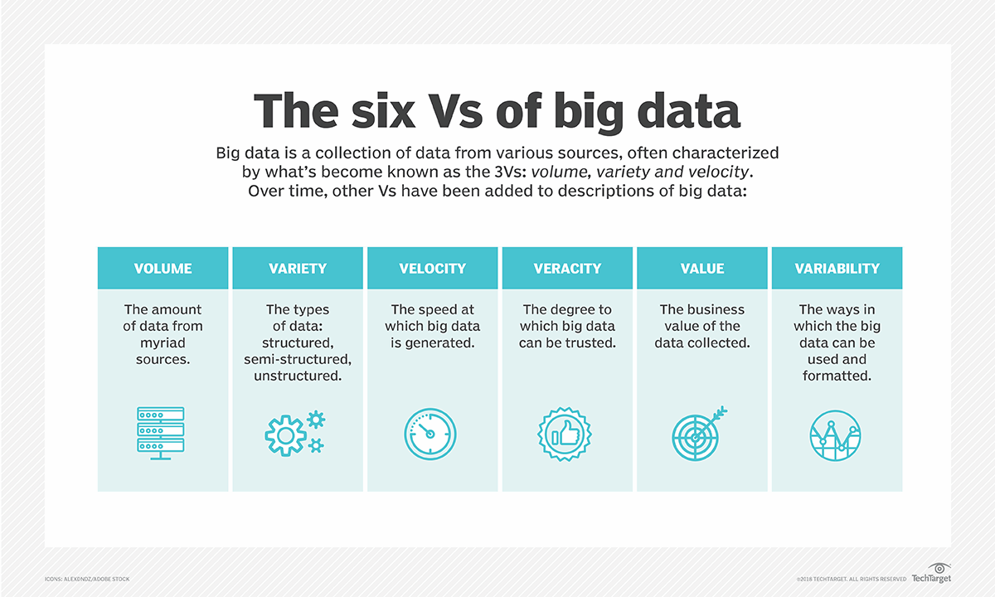

Slide 17
Volume
The name ‘Big Data’ itself is related to a size which is enormous.
Volume is a huge amount of data.
To determine the value of data, size of data plays a very crucial role. If the volume of data is very large, then it is actually considered as a ‘Big Data’. This means whether a particular data can actually be considered as a Big Data or not, is dependent upon the volume of data.
Hence while dealing with Big Data it is necessary to consider a characteristic ‘Volume’.
Example: In the year 2016, the estimated global mobile traffic was 6.2 Exabytes (6.2 billion GB) per month. Also, it was estimated that by the year 2020 we will have almost 40000 Exabytes of data.

Slide 18
Velocity
Velocity refers to the high speed of accumulation of data.
In Big Data velocity data flows in from sources like machines, networks, social media, mobile phones etc.
There is a massive and continuous flow of data. This determines the potential of data that how fast the data is generated and processed to meet the demands.
Sampling data can help in dealing with the issue like ‘velocity’.
Example: There are more than 3.5 billion searches per day are made on Google. Also, Facebook users are increasing by 22%(Approx.) year by year.

Slide 19
Variety
It refers to nature of data that is structured, semi-structured and unstructured data.
It also refers to heterogeneous sources.
Variety is basically the arrival of data from new sources that are both inside and outside of an enterprise. It can be structured, semi-structured and unstructured.
Structured data: This data is basically an organized data. It generally refers to data that has defined the length and format of data.
Semi- Structured data: This data is basically a semi-organised data. It is generally a form of data that do not conform to the formal structure of data. Log files are the examples of this type of data.
Unstructured data: This data basically refers to unorganized data. It generally refers to data that doesn’t fit neatly into the traditional row and column structure of the relational database. Texts, pictures, videos etc. are the examples of unstructured data which can’t be stored in the form of rows and columns.

Slide 20
Veracity
It refers to inconsistencies and uncertainty in data, that is data which is available can sometimes get messy and quality and accuracy are difficult to control.
Big Data is also variable because of the multitude of data dimensions resulting from multiple disparate data types and sources.
Example: Data in bulk could create confusion whereas less amount of data could convey half or Incomplete Information.

Slide 21
Value
After having the 4 V’s into account there comes one more V which stands for Value! The bulk of Data having no Value is of no good to the company, unless you turn it into something useful.
Data in itself is of no use or importance but it needs to be converted into something valuable to extract Information. Hence, you can state that Value! is the most important V of all the 6V’s.

Slide 22
Variability
How fast or available data that extent is the structure of your data is changing?
How often does the meaning or shape of your data change?
Example: if you are eating same ice-cream daily and the taste just keep changing.

Slide 23
Importance of Big Data
Companies use the big data accumulated in their systems to:
improve operations
provide better customer service
create personalized marketing campaigns based on speciﬁc customer preferences and, ultimately, increase proﬁtability.

Slide 24
What is Data Analytics?
Data analytics is the practice of examining data to answer questions, identify trends, and extract insights. When data analytics is used in business, it’s often called business analytics.
Who needs Data Analytics?
Professionals who can benefit from data analytics skills include:
Marketers, who utilize customer data, industry trends, and performance data from past campaigns to plan marketing strategies
Product managers, who analyze market, industry, and user data to improve their companies’ products
Finance professionals, who use historical performance data and industry trends to forecast their companies’ financial trajectories
Human resources and diversity, equity, and inclusion professionals, who gain insights into employees’ opinions, motivations, and behaviors and pair it with industry trend data to make meaningful changes within their organizations

Slide 25
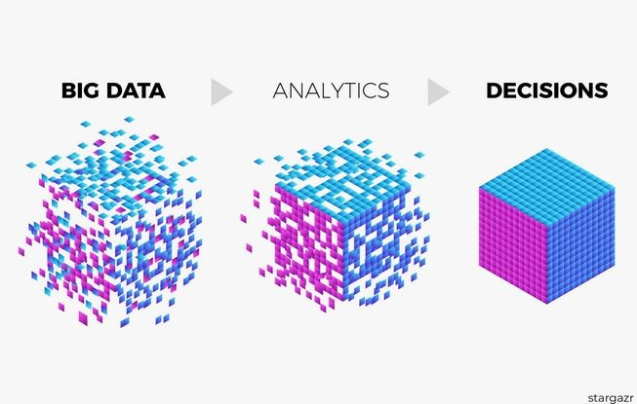
What is Big Data Analytics?
https://towardsdatascience.com/how-is-the-current-state-of-big-data-analytics-in-c ontrolling-1273c725ac6a

Slide 26
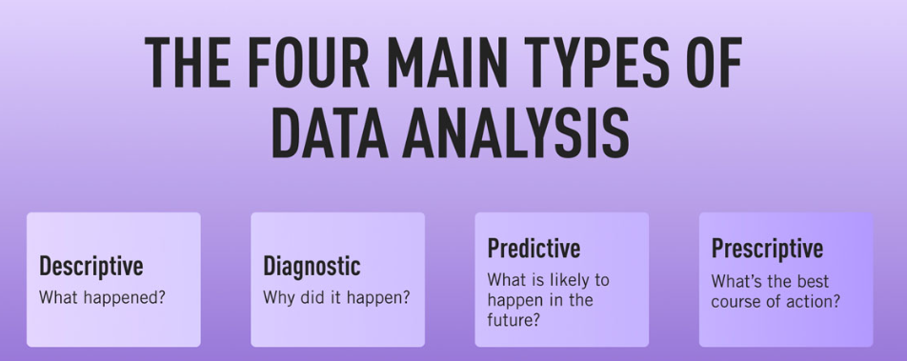
Main types of Data Analysis

Slide 27
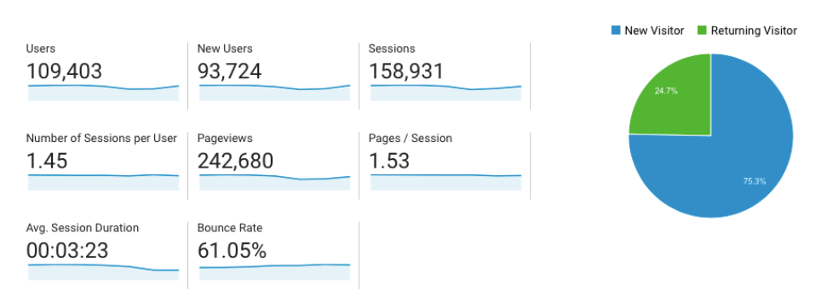
Descriptive (What happened?)
Descriptive analytics looks at what has happened in the past.
As the name suggests, the purpose of descriptive analytics is to simply describe what has happened; it doesn’t try to explain why this might have happened or to establish cause-and-effect relationships. The aim is solely to provide an easily digestible snapshot.
Google Analytics is a good example of descriptive analytics in action; it provides a simple overview of what’s been going on with your website, showing you how many people visited in a given time period, for example, or where your visitors came from. Similarly, tools like HubSpot will show you how many people opened a particular email or engaged with a certain campaign.

Slide 28
Descriptive (What happened?)
Descriptive analytics is the simplest type of analytics and the foundation the other types are built on. It allows you to pull trends from raw data and succinctly describe what happened or is currently happening.
Descriptive analytics answers the question, “What happened?”
For example, imagine you’re analyzing your company’s data and find there’s a seasonal surge in sales for one of your products: a video game console. Here, descriptive analytics can tell you, “This video game console experiences an increase in sales in October, November, and early December each year.”
Data visualization is a natural fit for communicating descriptive analysis because charts, graphs, and maps can show trends in data—as well as dips and spikes—in a clear, easily understandable way.

Slide 29
Descriptive (What happened?)
There are two main techniques used in descriptive analytics:
Data aggregation
Data aggregation is the process of gathering data and presenting it in a summarized format. Let’s imagine an ecommerce company collects all kinds of data relating to their customers and people who visit their website.
The aggregate data, or summarized data, would provide an overview of this wider dataset—such as the average customer age, for example, or the average number of purchases made.
Data mining
Data mining is the analysis part. This is when the analyst explores the data in order to uncover any patterns or trends. The outcome of descriptive analysis is a visual representation of the data—as a bar graph, for example, or a pie chart.
So: Descriptive analytics condenses large volumes of data into a clear, simple overview of what has happened. This is often the starting point for more in-depth analysis.

Slide 30
Diagnostic (Why did it happen?)
Diagnostic analytics addresses the next logical question, “Why did this happen?”
Taking the analysis a step further, this type includes comparing coexisting trends or movement, uncovering correlations between variables, and determining causal relationships where possible.
Continuing the aforementioned example, you may dig into video game console users’ demographic data and find that they’re between the ages of eight and 18. The customers, however, tend to be between the ages of 35 and 55. Analysis of customer survey data reveals that one primary motivator for customers to purchase the video game console is to gift it to their children. The spike in sales in the fall and early winter months may be due to the holidays that include gift-giving.
Diagnostic analytics is useful for getting at the root of an organizational issue.

Slide 31
Predictive (What is likely to happen in the future?
Predictive analytics is used to make predictions about future trends or events and answers the question, “What might happen in the future?”
By analyzing historical data in tandem with industry trends, you can make informed predictions about what the future could hold for your company.
For instance, knowing that video game console sales have spiked in October, November, and early December every year for the past decade provides you with ample data to predict that the same trend will occur next year. Backed by upward trends in the video game industry as a whole, this is a reasonable prediction to make.
Making predictions for the future can help your organization formulate strategies based on likely scenarios.

Slide 32
Prescriptive (What’s the best course of action?
Finally, prescriptive analytics answers the question, “What should we do next?”
In other words, prescriptive analytics shows you how you can best take advantage of the future outcomes that have been predicted. What steps can you take to avoid a future problem? What can you do to capitalize on an emerging trend?
Prescriptive analytics is, without doubt, the most complex type of analysis, involving algorithms, machine learning, statistical methods, and computational modeling procedures. Essentially, a prescriptive model considers all the possible decision patterns or pathways a company might take, and their likely outcomes.
This enables you to see how each combination of conditions and decisions might impact the future, and allows you to measure the impact a certain decision might have. Based on all the possible scenarios and potential outcomes, the company can decide what is the best “route” or action to take.

Slide 33
Prescriptive (What’s the best course of action?
An oft-cited example of prescriptive analytics in action is maps and traffic apps. When figuring out the best way to get you from A to B, Google Maps will consider all the possible modes of transport (e.g. bus, walking, or driving), the current traffic conditions and possible roadworks in order to calculate the best route. In much the same way, prescriptive models are used to calculate all the possible “routes” a company might take to reach their goals in order to determine the best possible option.
Knowing what actions to take for the best chances of success is a major advantage for any type of organization, so it’s no wonder that prescriptive analytics has a huge role to play in business.
So: Prescriptive analytics looks at what has happened, why it happened, and what might happen in order to determine the best course of action for the future.

Slide 34
Examples of Data Analytics
Big data analytics is used in many organizations to generate reports and dashboards based on huge data of past and present. Some of the examples of big data analytics are listed below:
1. Fraud detection report is commonly used in banking sectors to identify transactions involving fraud, hacking, unauthorized access to the account, etc.
2. Live tracking report that transportation sectors such as Meru, Ola, Uber, and Mega typically use to track cars, customer requests, payment processing, emergency warning, and find regular needs and revenue, and so on.
3. Sales forecast and plan analysis that is often used by all sectors to assess their customers’ sales, profits, and needs and also used to evaluate the future target, etc.
4. Often used for handling live data in many entertainment pages, share market, real-time Sensex data, etc., many reports focused on live data.
5. Generate different types of alerts based on various events, such as alerts created by the data center, using various big data analytics examples notifications.

Slide 35
Examples of Data Analytics
6. Google analytics reports that we can get how many users visit count, where the user is from, which computer the client is using, etc.
7. Nowadays, many healthcare organizations have quickly introduced big data predictive analytics to improve our daily lives. It has been used to update many healthcare sector procedures and has also been used to enhance outcomes for whole populations.
8. Applications of big data analysis have also played a critical role in many crises. Earthquake killed and injured many people in Nepal in April 2015. In this situation, SAS based in North Carolina was established by analytics, which played a massive role in rescue and relief operations.
9. In online and physical protection, big data analytics has been used to detect malicious activities, take different measures to deter such attacks, introduce real-time surveillance to minimize fraud activity, and also trigger alerts against suspicious acts.

Slide 36
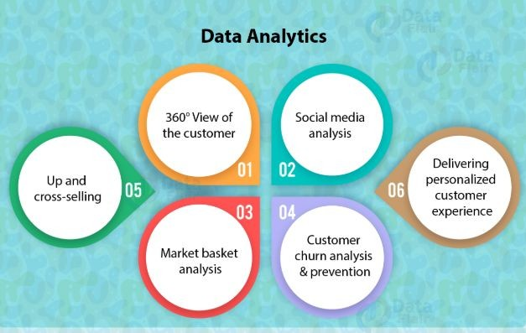
Data Analytics Usecases
https://data-flair.training/blogs/data-science-vs-data-analytics-infographic/

Slide 37
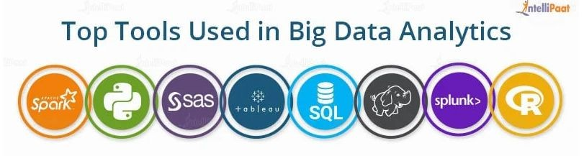
Tools for Big Data Analytics
https://intellipaat.com/blog/big-data-analytics/

Slide 38
Big Data Use cases in Different Domains
Big Data in Retail
Big Data in Healthcare
Big Data in Education
Big Data in E-commerce
Big Data in Media and Entertainment
Big Data in Finance
Big Data in Travel Industry
Big Data in Telecom
Big Data in Automobile

Slide 39
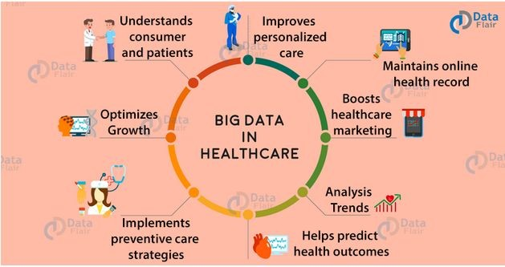
Big Data in Health Care
https://data-flair.training/blogs/big-data-in-healthcare-applications/

Slide 40
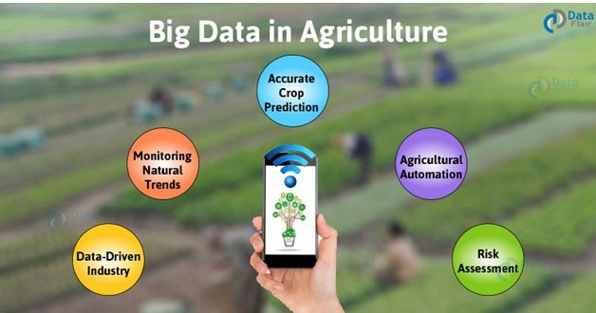
Big Data in Agriculture
https://data-flair.training/blogs/big-data-in-agriculture/

Slide 41
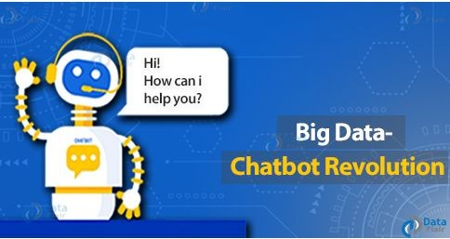
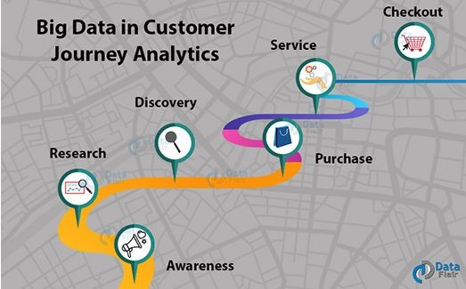
Big Data in Retail Industry
https://data-flair.training/blogs/big-data-in-retail-industry-real-world-uses-examples/

Slide 42
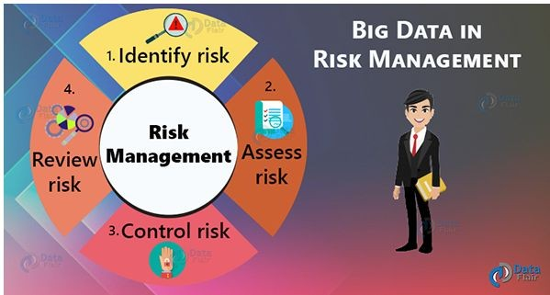

Big Data Applications in Bank
https://data-flair.training/blogs/big-data-in-banking/

Slide 43
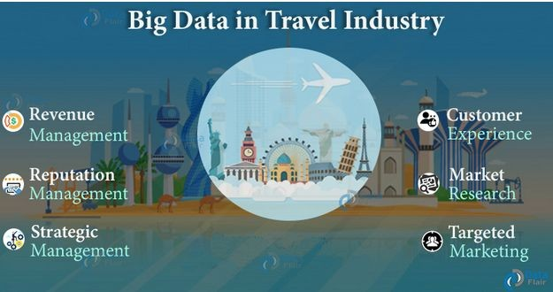
Big Data in Travel Industry
https://data-flair.training/blogs/big-data-in-travel-industry/

Slide 44
Data Analytics Usecases
Social Media Sentiment Analysis
https://www.preprints.org/manuscript/202005.0015/v1
https://www.regenhealthsolutions.info/2020/04/09/usc-resea rchers-analyze-covid-19-misinformation-on-twitter/
Market Basket Analysis
https://www.analyticsvidhya.com/blog/2014/08/effective-cro ss-selling-market-basket-analysis/
https://medium.com/@notesharsha/market-basket-analysis-sneaky-psychology-of-supermarkets-simple-guide-using-python-eacfd33cc882

Slide 45

Emerging Big Data Ecosystem
Data devices
Games, smartphones, computers
Data collectors
Phone and TV companies, Internet, Gov’t
Data aggregators
Websites, credit bureaus, media archives
Data users & buyers
Banks, law enforcement, marketers, employers

Slide 46
Data Analytics Lifecycle
The data analytics life cycle is required for problems related to big data and data science applications.
The method is iterative to depict a specific project; the project returns to an earlier phase as new information is discovered.
The life cycle of data analytics defines best practices in the analytical process from discovery to project completion.
You will still learn something new in a phase as you can see in the graphic to allow you to go back and refine the research performed in the preceding process.
For this purpose, the graphic is displayed as a loop and circular arrows are meant to demonstrate that you should travel iteratively between phases before you have enough details to keep going forward.
The callouts are questions you can ask yourself to determine whether you have made adequate progress to proceed to the next step of the cycle.
Phases involved in the process are data creation, data preparation, system preparing, plan construction, results communication, and operationalization.

Slide 47
Data Analytics Lifecycle
Phase 1: Discovery
Phase 2: Data Preparation Phase 3: Model Planning
Phase 4: Model Building Phase 5: Communicate Results
Phase 6: Operationalize

Slide 48
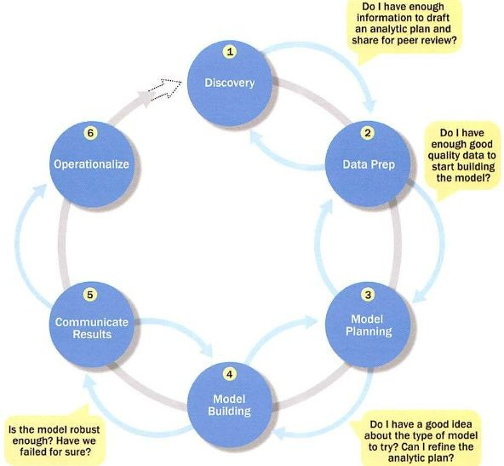
Overview of
Data Analytics Lifecycle

Slide 49
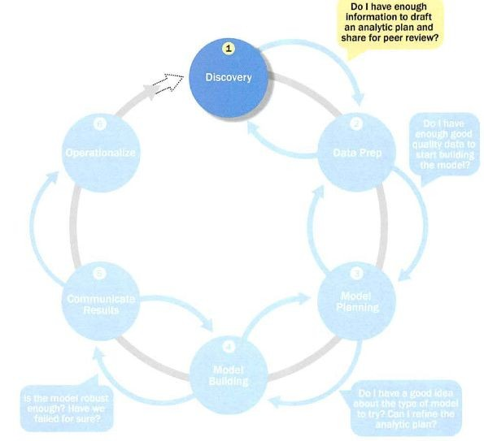
Phase 1: Discovery

Slide 50
Phase 1: Discovery
This is the first step in the life cycle of data analytics.
The data science team has to analyze the problem during this process and establish meaning and understanding.
Group will find out what data sources are needed and accessible for the project.
The team also builds up initial hypotheses that can be checked with the data later.
Throughout this step, the team will carry out five key activities:
define the data sources
capture the aggregate data sources
review the raw data
determine the required data structures and resources and
scope the kind of data infrastructure needed for this type of problem.

Slide 51
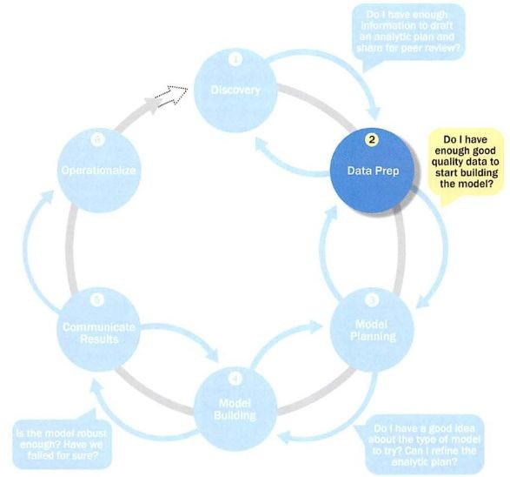
Phase 2: Data Preparation

Slide 52
Phase 2: Data Preparation
Preparing the Analytic Sandbox
Performing ETLT Learning about the Data Data Conditioning Survey and Visualize
Common Tools for Data Preparation

Slide 53
Phase 2: Data Preparation
The preparation of data involves some cleaning as well as choosing some appropriate samples for training and testing. Also, any appropriate combining or aggregating of datasets or elements is done during this level.
This step aims to create the dataset to be used in the process’s subsequent modeling phase.
This phase takes a lot of time and is the most labor-intensive as compared to other phases.
Almost half of the time of the project is spent in this phase. In this phase, the team needs to create an environment that is separate from the production environment. This is done by creating an analytical sandbox.
ETLT is performed in which Extraction, Transformation, and Loading (ETL) of the data and Extract, Load and Transform (ELT) of the data is executed by the teams to get data into the sandbox for analysis. The team also has to think about the data conditioning methods to turn it into a format to facilitate further analysis.

Slide 54
Phase 2: Data Preparation
This may be done by visualizing the data using charts and graphs to understand the data in a better way.
This may help in understanding the trends, outliers, cycles, and various relations between the data variables. Many a time, the team underestimates the phase of data preparation and therefore ends up coming back to this phase.
Sometimes, when the team is in the model building phase, they realize that the data they are working on is not up to the mark and not giving proper results. As a result, they have to go back to the data preparation phase to check exactly where things went wrong.

Slide 55
Preparing the Analytic Sandbox
The data preparation process includes the existence of an analytical sandbox (workspace) in which the team can work with the data for the duration of the project and conduct analytics.
While developing the analytical sandbox, the relevant data of large amounts and variety is aggregated.
This can include all kinds of data like summary-level aggregated data, raw data feed, and unstructured text data, and data from call logs or weblogs, depending upon the kind of analytics the team wants to undertake.
Consider an example where the team would need to deal with financial data from a client. Instead of dealing with the production version of the organization’s main database, the team will access a copy of the financial data from the computational sandbox, as this will be closely managed and required for financial reporting. This is always the case that data scientists need the full amount of data to work on but have access to restricted data.

Slide 56
Preparing the Analytic Sandbox
The size of the analytical sandbox can vary depending on the project.
There is a good rule one should keep in mind while making the sandbox.
The size of the sandbox should be planned at least 5–10 times the size of the original datasets, partly because multiple copies of the data can be created to serve as specific tables or data stored for specific kinds of analysis.

Slide 57
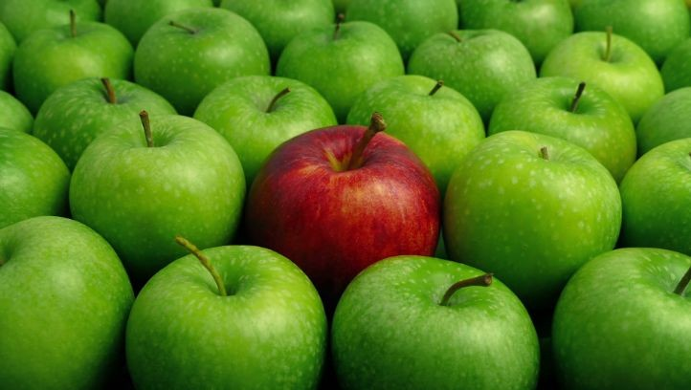
Outlier
http://thewisdomdaily.com/why-we-need-outliers/

Slide 58
Performing ETL
ETL consists of process series and application series.
To build a data center, it is done to combine all the data coming from various sources.
It consumes quite a sizeable amount of effort to develop a data warehouse. It needs data analysts, database designers, and software developers to have the skills.
The data warehouse changes periodically with the source of the data. Additionally, the data warehouse needs to evolve as business shifts – to maintain its value as a tool for decision-makers, as a consequence the ETL often changes and expands.
ETL stands for extract, load, transform. Information is extracted from an OLTP database in the ETL process, then transformed to suit the data warehouse system, and eventually loaded into the database of the data ware-house.
The extraction of data can also be achieved from non-OLTP systems. The ETL consists of three main processes: extraction, transformation, and loading.

Slide 59
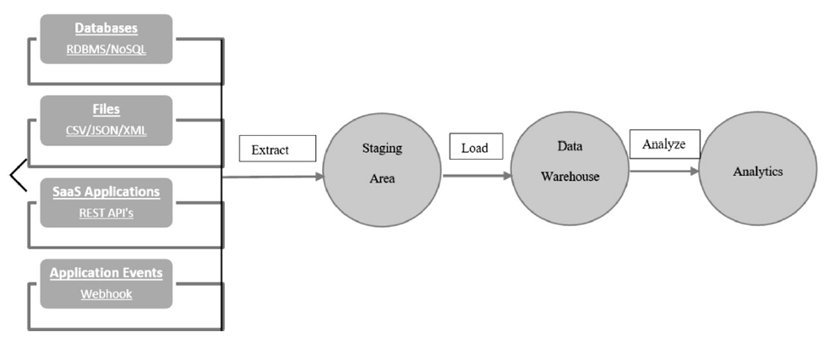
ETL Process
The ETL process

Slide 60
Extraction
This is the very first step in the cycle of ETL. Few items should be remembered when carrying out the extraction.
The team is expected to be well aware of the use of ODBC/JDBC drivers to link to data-base sources, should understand all data structures of the data sources, and should also be aware of the handling of resources of various nature.
Extraction takes place in phases which are the initial extraction and the data extraction modified. Initial extraction only takes place until the data is collected in vast amounts from various resources.
The gradual extraction is called data capture modification (CDC). This method extracts back in time the data that has changed about a well-defined case.
Based on the update cycle and company requirements, this phase is periodic.

Slide 61
Transformation
In ETL’s second phase, the data is properly cleaned and is ready for further use.
The team makes sure the data is correct, complete, coherent, and unambiguous.
The process involves washing, installation, and data integration.

Slide 62
Load
The final step on ETL is to load the data into the multidimensional structure of the target.
Through this, the data extracted and transformed through previous steps is loaded into the dimensional framework for further processing where it is accessed by the team.

Slide 63
The data scientists often want to hold the raw data as it is and load it into the warehouse. The rationale for this approach is that the conservation and preservation of raw data in the sandbox is of great importance before any transformation takes place.
Consider, for example, an essay on credit card use for fraud detection. Outliers in this data population will also reflect high-risk transactions that may suggest a fraudulent activity on the credit card.
Now, if ETL is used, it will accidentally clean or filter out the outliers required to detect fraudulent credit card activity when analyzing the data. The team will want clean data and aggregated data and may need to maintain a backup of the original data to compare or assess for patterns and insights that may have existed in the data before the cleaning process.
The team may require to consider how to parallel the transfer of datasets into the sandbox, depending on the size and number of the data sources. For this reason, the transfer of large volumes of data is often referred to as the big ETL.
Many websites use APIs to provide access to large amounts of data to support projects. Twitter API is a fine example of such an API that allows millions of tweets to be downloaded to do projects.

Slide 64
Learning about the Data
Determines the data available to the team early in the project
Highlights gaps – identifies data not currently available
Identifies data outside the organization that might be useful

Slide 65
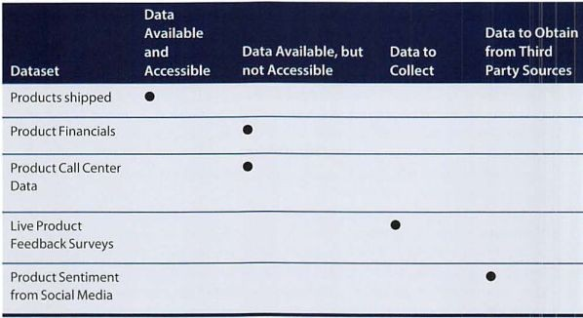
Learning about the Data Sample Dataset Inventory

Slide 66
Data Conditioning
Cleaning data
Normalizing
datasets
Managing Missing data, Outliers, and Unwanted
Data
Performing transformation

Slide 67
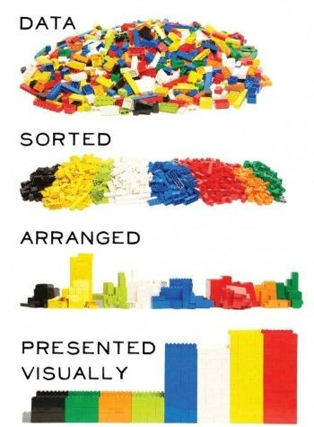
Survey and Visualize
https://www.pinterest.com/pin/121808364893437974/

Slide 68
Survey and Visualize
Leverage data visualization tools to gain an overview of the data
“Overview ﬁrst, zoom and ﬁlter, then details-on-demand”
This enables the user to ﬁnd areas of interest, zoom and ﬁlter to ﬁnd more detailed information about a particular area, then ﬁnd the detailed data in that area
https://docs.google.com/spreadsheets/d/1TY_bUVH0x4sI72Snf WVhPVCDqIvawi3K-VjWwOas4/edit#gid=892363025
https://towardsdatascience.com/how-data-visualization-works-12c6a4543d52

Slide 69
Survey and Visualize Guidelines and Considerations
Assess the granularity of the data, the range of values, and the level of aggregation of the data
Does the data represent the population of interest?
Check time-related variables – daily, weekly, monthly? Is this good enough?
Is the data standardized/normalized? Scales consistent?
For geospatial datasets, are state/country abbreviations consistent

Slide 70
Common Tools for Data Preparation
Hadoop - Hadoop allows data scientists to explore the complexities that exist in the data, even if they cannot make sense of it. It allows data scientists to store data where it is, and that is the whole point of data discovery. A data scientist does not need to grasp the specifics when dealing with large quantities of data.
Alpine Miner - This tool includes a graphical user interface (GUI) to develop analytical workflows, including data manipulation and a sequence of analytical events on PostgreSQL and other big data sources, such as structured data mining techniques (e.g., first select the top 100 customers, and then run descriptive statistics and clustering).

Slide 71
Common Tools for Data Preparation
OpenRefine - OpenRefine is a standalone open-source tool for data cleanup and transformation to other formats, called data wrangling. The operations are more like spreadsheets, i.e. on rows and columns. This tool is mostly used for cleaning messy data, transformations of data, parsing data from websites, etc.
Data wranglers With Trifacta Wrangler, any user with a Mac or Windows machine and an Internet connection can download, install, and start using Trifacta immediately. Trifacta Wrangler empowers analysts to wrangle various data sources on their desktop in preparation for use in analytical or visualization tools such as Tableau.
The data preparation phase takes a lot of time, but it lays the foundation for further work. The quality data is now ready to get fed into the model.

Slide 72
Common Tools for Data Preparation
Alpine Miner
Open Refine
Data Wrangler
Hadoop
Tool for data cleansing & transformat ion
provides a GUI for creating analytic workflows
free, open source tool for working with messy data
Perform parallel ingest and analysis

Slide 73
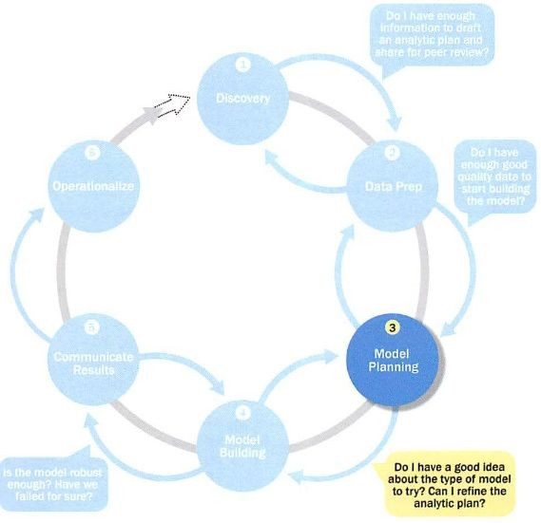
Phase 3: Model Planning

Slide 74
Phase 3: Model Planning
Data Exploration & Variable Selection
Model Selection
Common Tools for Model Planning Phase

Slide 75
Phase 3: Model Planning
Based on the type of project, the team selects a possible analytical model and the corresponding variables and other inputs.
The model planning phase may seem straightforward, but it is often necessary to perform extra data exploration, data conditioning, and transformations to prepare the data for the model building phase.
Some of the activities to be considered in this phase are as follows:
Assessing the structure of the datasets: The structure of the datasets is to be studied properly. It is one factor that dictates the tools and analytical technique for the next phase.
To ensure that the analytical technique will meet the goals and objectives, the team is trying to achieve.
In some cases, a single model does not suffice the requirements. Therefore, series of techniques as part of the large analytical work-flow is needed.

Slide 76
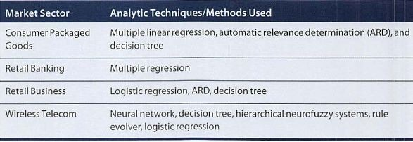
Phase 3: Model Planning
Model Planning in Industry Verticals
Example of other analysts approaching a similar problem

Slide 77
Data Exploration and Variable Selection
In this step, the main objective of exploring the data is to know the relationships among the variables.
Not only is it important to understand the relationships between the input variables and the outcome variables, but it is also important to understand the relationship, if any, between the input variables.
When there is a significant correlation between two or more input variables, it may be useful to perform some variable reduction activities.

Slide 78
Model Selection
The main goal of this sub step is to choose an analytical technique or a short-list of candidate techniques based on the end of the project or the purpose of analysis.
For the selection of a model, the types of input and output variables play an important role.
The team has to decide whether they should use one single model or series of models depending on the type of analysis they are doing.
After selecting the model, a proper analytical tool is to be determined to fit the selected model.
It is often useful to revisit the analytic challenge at this stage of the project and to ensure that the analytic challenge is still relevant and that there is not any scope creep in the project.

Slide 79
Model Selection
Determine whether to use techniques best suited for structured data, unstructured data, or a hybrid approach
Teams often create initial models using statistical
software packages such as R, SAS, or Matlab
The team moves to the model building phase once it has a good idea about the type of model to try

Slide 80
Common tools for the model planning phase
R
R is the leading analytical method in the industry and is widely used to process statistics and data.
This can manipulate the data easily and show it in a variety of ways. In many respects, SAS has been overtaken, such as data performance, production, and outcome.
R installs and runs on several platforms, including UNIX, Windows, and macOS. It has 11,556 packages, which allows you to browse by type of packages.
R also provides tools for the automated installation of all packages as per user requirement, which can be conveniently installed with big data, too.

Slide 81
Common tools for the model planning phase
Tableau
Tableau Public is a free program that links any data source, whether it be a corporate data warehouse, Microsoft Excel, or web-based data, and generates visualizations of results, charts, dashboards, etc., with web-based real-time updates.
They can also be shared with the customer, or via social media.
This allows the right to view the file in different formats.
The big data capabilities of Tableau make them important, and one can better analyze and visualize the data than any other business program for data visualization.

Slide 82
Common tools for the model planning phase
SAS
SAS is easy to access, is easy to handle, and can analyze data from any source.
SAS has launched a wide range of customer intelligence products and various web, social media, and marketing analytics SAS modules which are commonly used to profile customers and prospects.
This can also predict, monitor, and refine their social behaviors.

Slide 83
Common Tools for the Model Planning Phase
SQL Analysis services
SAS/ ACCESS
R
Can perform
in-database analytics of common data mining functions, involved aggregations, and basic predictive models
R contains many packages for data analysis and graphical presentation
Provides integration between SAS and the analytics sandbox

Slide 84
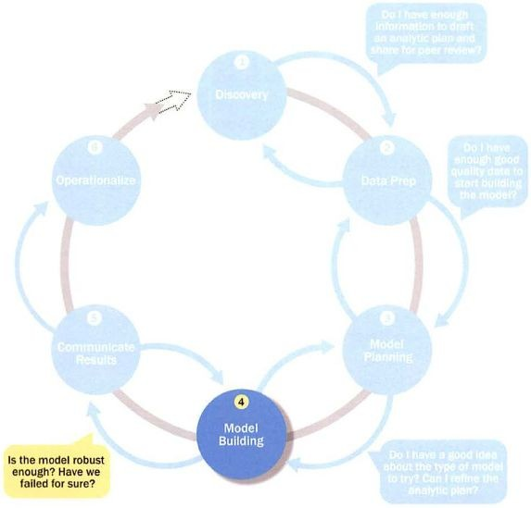
Phase 4: Model Building

Slide 85
Phase 4: Model Building
In the model building phase, the selected analytical technique is applied to a set of training data.
This process is known as “training the model”.
A separate set of data, known as the testing data, is then used to evaluate how well the model performs.
This is sometimes known as the pilot test. Often, the fitted model is to be applied to future observations.
So, it is not typically sufficient to obtain the best model that explains all of the data; one must build a model that adequately predicts the future.

Slide 86
Phase 4: Model Building
Execute the models defined in Phase 3
Develop datasets for training, testing, and
production
Develop analytic model on
Test On
Training Data
Testing Data

Slide 87
Phase 4: Model Building
Question to consider
Does the model appear valid and accurate on the test data?
Does the model output/behavior make sense to the domain experts?
Do the parameter values make sense in the context of the domain?
Is the model sufficiently accurate to meet the goal?
Does the model avoid intolerable mistakes?
Are more data or more inputs needed? Do any of the inputs need to be transformed or eliminated?
Will the kind of model chosen support the runtime requirements?
Is a different form of the model required to address the business problem? If so, go back to the model planning phase and revise the modeling approach.

Slide 88
Common Tools for the Model Building Phase
SAS
It is one of those data analysis tools that are designed specifically for statistical operations.
SAS is a closed-source business method used for data mining by major corporations.
SAS uses the programming language of base SAS to implement statistical modeling.
It is widely used by professionals and businesses working on stable commercial applications.
As a data scientist, SAS offers various mathematical databases and tools that you can use to model and coordinate your tests.
While SAS is highly reliable and strongly supported by the company, it is very costly and is used mainly by larger industries.

Slide 89
Common Tools for the Model Building Phase
Apache Spark
Apache Spark, or simply Spark, is a versatile analytics engine and the data analysis platform that is most used.
Spark is intended mainly for batch processing and stream processing.
It comes with several APIs that make routine access to data for machine learning, SQL server, etc., easier for data scientists.
It is an improvement over Hadoop and can run 100 times faster than MapReduce.
Spark has many machine learning APIs that can help data scientists predict data effectively.

Slide 90
Common Tools for the Model Building Phase
BigML
BigML offers structured software that uses cloud computing to meet market requirements.
BigML is another commonly used data science tool.
It offers a fully interactive, cloud-based GUI platform that you can use to process machine learning algorithms.
It allows collaborative data visualization and allows you to export visual graphs to your smartphone or IoT computers.
BigML offers an easy-to-use web interface using REST APIs, and you can create a free account or a paid account depending on your data needs.

Slide 91
Common Tools for the Model Building Phase
MATLAB
It is a closed-source software providing matrix functions, algorithmic execution, and simulation of statistical results.
MATLAB is most widely used in various fields of science.
MATLAB graphics library helps you to create powerful visualizations. Even MATLAB is used for manipulating images and signals.
This makes a very versatile tool for data scientists for solving all issues, from data cleaning and analysis to more sophisticated deep learning algorithms.

Slide 92
Common Tools for the Model Building Phase
Jupyter
Project Jupyter is an open-source framework based on IPython, which is designed to help developers create open-source software and experience immersive computing.
Jupyter supports various languages, including Julia, Python, and R.
It is a website for web applications used for writing live code, visualizations, and presentations.
Jupyter is a widely used platform that meets data science requirements.
It is 100% open-source and is therefore free.
Colaboratory is an online Jupyter program that runs on the cloud and stores data on Google Drive.

Slide 93
Common Tools for the Model Building Phase
Scikit
Scikit-learn is a library based on Python, used to implement machine learning algorithms.
A tool widely used for data science and analysis is fast and simple to implement and supports a range of machine learning features such as preprocessing, classification, regression, clustering, and reduction in dimensions.

Slide 94
Common Tools for the Model Building Phase
TensorFlow
An open-source and ever-evolving toolkit that is famous for its performance and high computational capabilities.
TensorFlow has become a popular machine learning tool.
This is commonly used for sophisticated machine learning applications such as deep learning. Developers called TensorFlow after tensors that are multidimensional arrays.
The capability of TensorFlow to run both CPU and GPU gives it an advantage in the computing power of sophisticated machine learning algorithms.

Slide 95
Common Tools for the Model Building Phase
Weka
Weka, or Waikato Environment for Knowledge Analysis, is a tool written in Java for machine learning.
This involves various methods of machine learning, such as classification, clustering, regression, visualization, and preparation of data.
It is an open-source GUI program, which enables the application of machine learning algorithms through an interactive interface.

Slide 96
Common Tools for the Model Building Phase
Commercial Tools
○
SAS Enterprise Miner
– built for enterprise-level computing and
analytics
○
SPSS Modeler (IBM)
– provides enterprise-level computing and
analytics
○
Matlab
– high-level language for data analytics, algorithms, data
exploration
○
○
Alpine Miner
– provides GUI frontend for backend analytics tools
STATISTICA and MATHEMATICA
– popular data mining and
analytics tools

Slide 97
Common Tools for the Model Building Phase
Free or Open Source Tools
○
○
○
○
R and PL/R
- PL/R is a procedural language for PostgreSQL with R
Octave
– language for computational modeling
WEKA
– data mining software package with analytic workbench
Python
– language providing toolkits for machine learning and
analysis
○
SQL
– in-database implementations provide an alternative tool

Slide 98
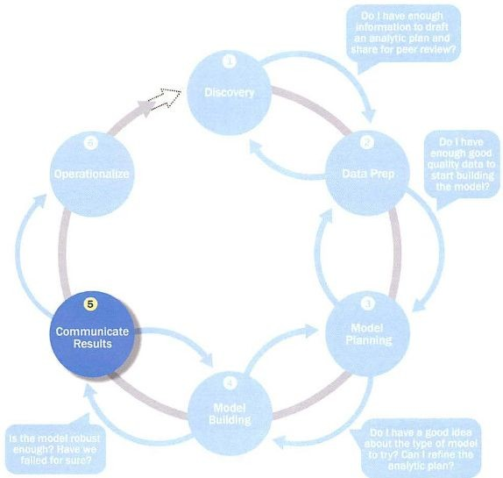
Phase 5: Communicate Results

Slide 99

Phase 5: Communicate Results
Determine if the team succeeded or failed in its objectives

Slide 100
Phase 5: Communicate Results
This is the second last phase of the analytics cycle. After obtaining an acceptable model, the team has to communicate the project’s findings and the business value of the model to the sponsors and the stakeholders.
If the desired business outcome is not obtained, this result also must be communicated.
The results can be communicated by preparing presentations for sponsors and analysts. While the communication results phase may seem to be the simplest and most straightforward, it can often be the most challenging part of the exercise.

Slide 101
Phase 5: Communicate Results
Furthermore, unless the project sponsors and stakeholders are kept periodically updated on the project as well as the objective of the project, it is typical for someone to state, “This is not what I asked for!” So it is important to remind the audience about the business problem and the scope of the project.
The team has to build a strategy to communicate the findings, by including caveats, assumptions, and any limitations of results. They also add the recommendation for future work or improvements to the existing processes.

Slide 102

Phase 5: Communicate Results
Assess if the results are statistically significant and valid.

Slide 103
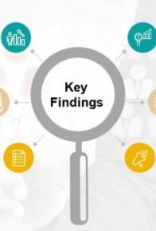
Phase 5: Communicate Results
Communicate and document the key findings and major insights derived from the analysis.

Slide 104
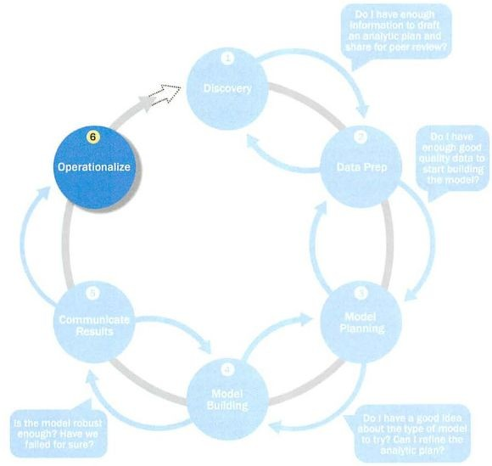
Phase 6: Operationalization

Slide 105
Phase 6: Operationalization
When the stakeholders agree to implement the model in the production environment, the operationalization phase begins.
Depending on the organization, the project team may be responsible for the model’s implementation or may simply transfer the code and other technical documentation to a different team.
During this phase, it is important to establish the approach to monitor the performance of the model after it is placed into production.
Implementing the model in the test environment helps to minimize impacts on production.
It is common to run a pilot program before fully implementing the model in production.

Slide 106
Phase 6: Operationalization
Running a pilot helps minimize risk and further demonstrates the business value.
Testing the model in a live setting allows the team to learn from the deployment and make necessary adjustments before launching across the enterprise.
After the model is placed into production, it is often necessary to monitor the model’s performance and establish a process to retrain and update the model.
Any further communication of results often occurs during the operationalization phase; the executives will be interested in knowing the return on investment from their investment.

Slide 107
Phase 6: Operationalize
The team sets up a the work in a controlled way
pilot project to deploy
effectively by undertaking small scope, pilot
Risk is managed
deployment before a wide-scale rollout
During the pilot project, more
team executes the algorithm
efficiently in the database
To test the model in a live setting, consider running the model in a
production environment
for a discrete set of products or a single
line of business
●
Monitor model accuracy
and retrain the model if necessary

Slide 108
Case Study: Global Innovation Network and Analysis (GINA)
In 2012 EMC’s new director wanted to improve the company’s engagement of employees across the global centers of excellence (GCE) to drive innovation, research, and university partnerships.
This project was created to accomplish
Store formal and informal data
Track research from global technologists
Mine the data for patterns and insights to improve the team’s operations and strategy

Slide 109
Phase 1: Discovery
Team members and roles
Business user, project sponsor, project manager – Vice President from Oﬃce of CTO
BI analyst – person from IT
Data engineer and DBA – people from IT
Data scientist – distinguished engineer

Slide 110
Phase 1: Discovery
The data fell into two categories
Five years of idea submissions from internal innovation contests
Minutes and notes representing innovation and research activity from around the world
Hypotheses grouped into two categories
Descriptive analytics of what is happening to spark further creativity, collaboration, and asset generation
Predictive analytics to advise executive management of where it should be investing in the future

Slide 111
Phase 2: Data Preparation
Set up an analytics sandbox
Discovered that certain data needed conditioning and normalization and that missing datasets were critical
Team recognized that poor quality data could impact subsequent steps
They discovered many names were misspelled and problems with extra spaces

Slide 112
Phase 3: Model Planning
The study included the following considerations
Identify the right milestones to achieve the goals
Trace how people move ideas from each milestone toward the goal
Tract ideas that die and others that reach the goal
Compare times and outcomes using a few different methods

Slide 113
Phase 4: Model Building
Several analytic method were employed
NLP on textual descriptions
Social network analysis using R and Rstudio
Developed social graphs and visualizations

Slide 114
Phase 5: Communicate Results
Study was successful in in identifying hidden innovators
Found high density of innovators in Cork, Ireland
The CTO oﬃce launched longitudinal studies

Slide 115
Phase 6: Operationalize
Deployment was not really discussed
Key ﬁndings
Need more data in future
Some data were sensitive
A parallel initiative needs to be created to improve basic BI activities
A mechanism is needed to continually reevaluate the model after deployment

